Slide 1
Web Design Fundamentals /
Basic Web Design
Web Design Principles and Typography – ITWD103 / ITWD113

Slide 2
Designing “Home" Page
a "who we are" or "who I am" message
a mission or purpose statement
contact information
update notice
copyright notice disclaimer (for ex: Though we try to keep the information up-to-date, some information may not be the most current. OR "This list does not constitute an endorsement of any one or more of the products .")
If the site is for a business or organization, it is important to include an address, phone number and email contact.
If the site is a personal site, disclosing an address or phone number is not advised because of privacy issues.
http://mason.gmu.edu/~montecin/webdesign.htm

Slide 3
Web Content
should match the purpose
should be well organized
should be spellchecked
should observe correct english (or the appropriate language). Some sites have information in more than one language, depending upon the possible audiences.
should be current information
should be appropriate for the audience
http://mason.gmu.edu/~montecin/webdesign.htm

Slide 4
Level of Web Technology
Minimal style - mostly text, little or no graphics (quick loading, does not require lots of memory or a high end graphic card)
Middle of the road style - some graphics to add an element of design or style, which compliments the information, but does not detract from the main purpose (still easy to load, may be more appealing than minimalism
High tech style - Lots of graphics, animation, java applets, "art" text, video clips, etc. (could be suitable for an audience of tekkies with high-end equipment, but could lose the average audience waiting for the images to load or trying to navigate links not clearly identified as such).
http://mason.gmu.edu/~montecin/webdesign.htm

Slide 5
Page Design
Include a "back to home" link
Use a consistent template on each page
Create a uniform color scheme (with limited color palate)
Be sure there is sufficient contrast between background and text
Avoid a too large font that SHOUTS*
Avoid a too small font that is hard to read*
Place important information near the top
Avoid long lists of links if possible.
Categorize lists in smaller chunks and provide internal tags
Provide a table of contents (with links to find information in a long list)
Organize your material to too much scrolling to find content
* The user can override your fonts by setting her/his browser font size and style.
http://mason.gmu.edu/~montecin/webdesign.htm

Slide 6
WEB TYPOGRAPHY
WEB TYPOGRAPHY
WEB TYPOGRAPHY

Slide 7
Type Design Principles
Type can flexibly express emotion, tone, and structure. Most of the type principles that apply to paper-based design apply to the Web as well.
CONSIDER:
Choose fewer fonts and sizes
Use available fonts
Design for legibility
Avoid using text as graphics
Notes:
Legibility is the degree to which glyphs (individual characters) in text are understandable or recognizable based on appearance

Slide 8
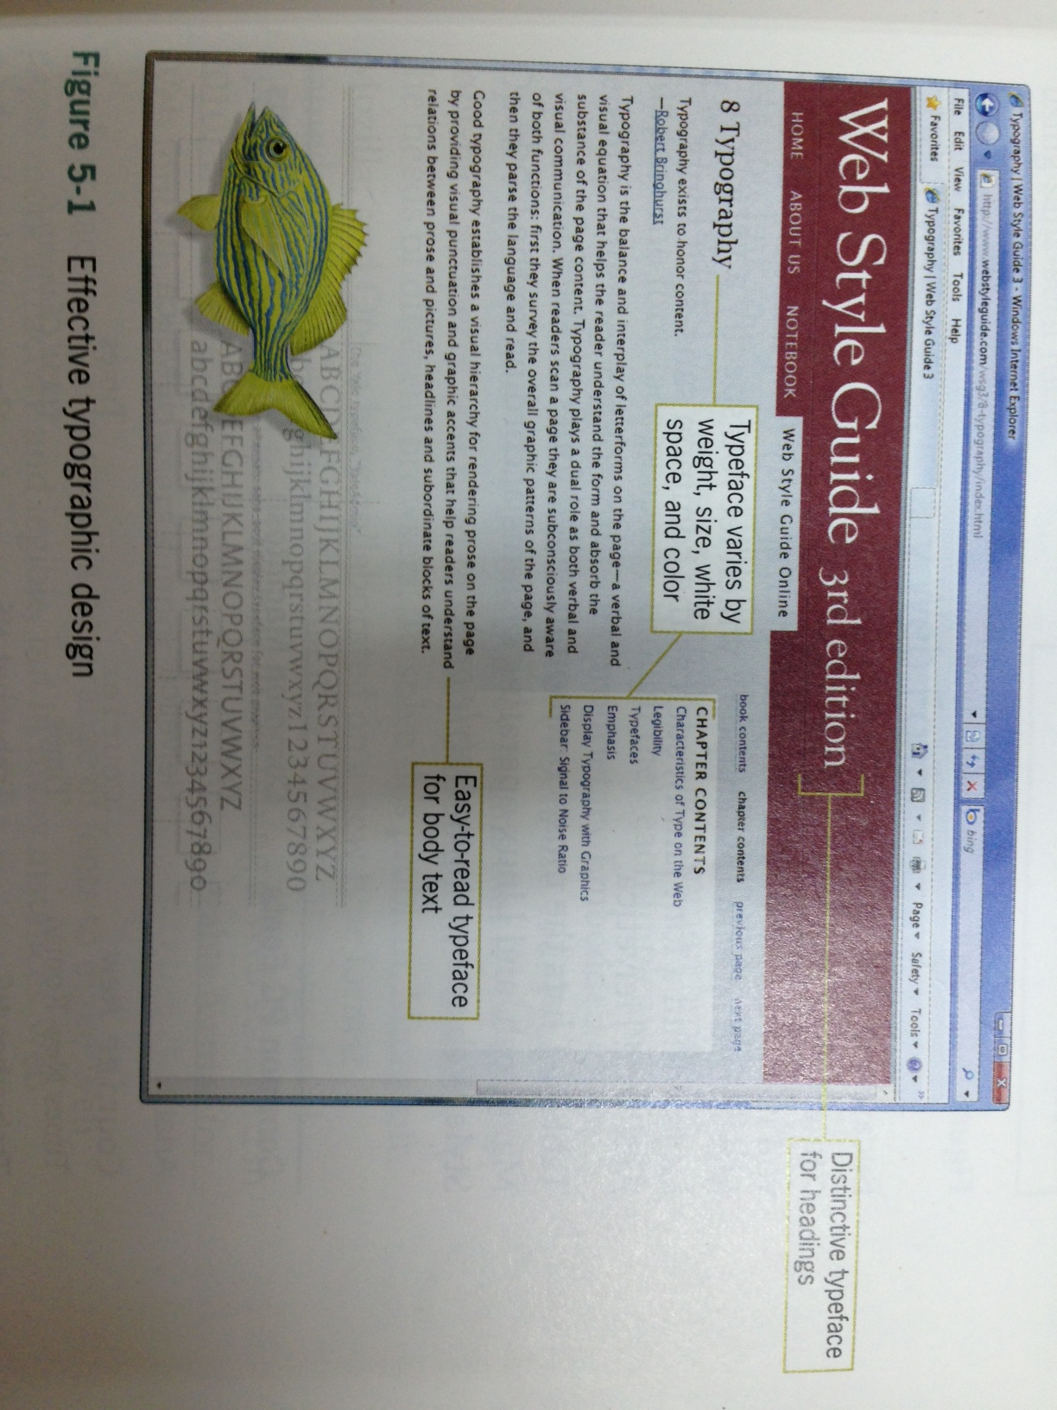
Description: The site has strong typographic identity yet uses only two typefaces and by varying the weight, size, white space and color of the text.

Slide 9
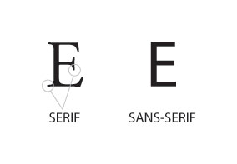
Serif and Sans-Serif Type
To control more effectively how text appears on your pages, just think in terms of font families, such as serif and sans-serif typefaces rather than specific styles.

Slide 10
END OF MODULE 8

